Slide 1


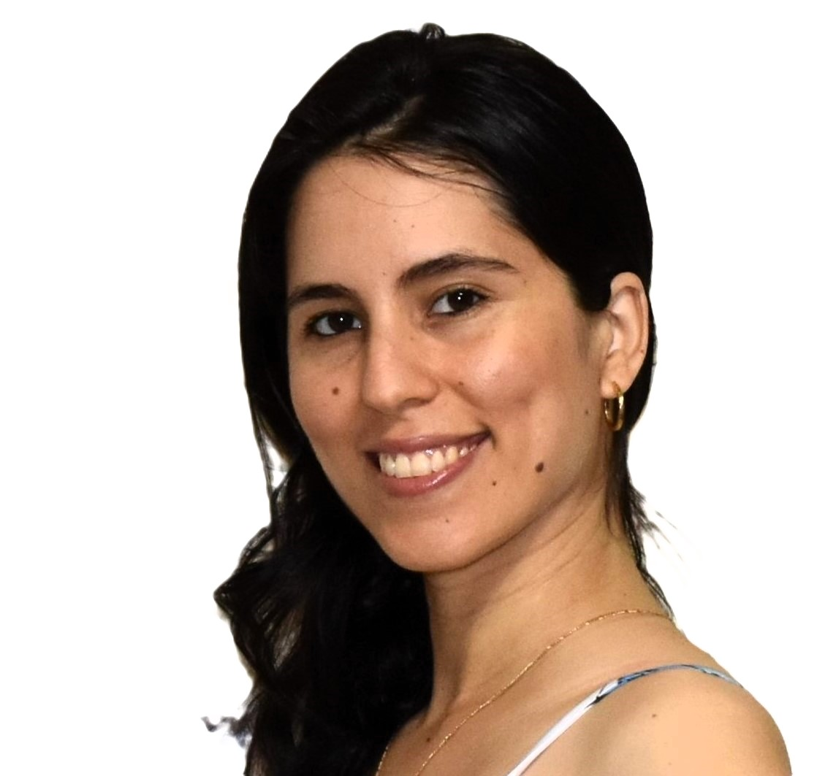


Florida Atlantic University
Project Title: Breast Cancer Stage Classification with miRNA
Team Members (Group 44)
Joshua Adegboyo: jadegboyo2023@fau.edu
Anika Baro Villa: abarovilla2021@fau.edu
Nicholas Campos: ncampos2022@fau.edu
Brehon Parker: bparker2012@fau.edu
Sponsor/Project Advisor
Dr. Ali Ibrahim: aibrahim2014@fau.edu

Slide 2
Agenda
Project Goals
Project Testing
1
5
Project Requirements/Constraints
Demonstration
2
6
Project Design
Discussion
3
7
5
Project Implementation
4

Slide 3





Project Goals
1

Slide 4
Overall Goal
To develop a stage-wise breast cancer classification system using miRNA expression data from TCGA by integrating traditional, deep learning, and clustering-based feature selection methods and evaluating them through multiple classifiers.
Specific Project Goals
Build a fully reproducible, leakage-free pipeline for:
Normal vs Stage I
Normal vs Stage II
Normal vs Stage III
Normal vs Stage IV
Implement three independent feature-selection families:
Traditional: SFS, Chi-Square, LASSO, Variance Threshold
Deep Learning: FNN, DAE, 1D-CNN, LSTM
Clustering: K-Means, Spectral, GMM, Hierarchical
Generate Top-5, Top-10, Top-15 biomarker lists for every stage × every method family
Develop consensus miRNA panels combining all three method families
Train classifiers (KNN, SVM, LR, RF) using these consensus features
Prepare project demonstration, poster, and final presentation

Slide 5
Project Requirements/Constraints
2

Slide 6
Functional Requirements
Must support stage-wise analysis
Non-Functional Requirements
Reproducibility: Fixed seeds, identical preprocessing across notebooks
Explainability: Feature importance, coefficient plots, weight rankings
Performance: Must be runnable within Colab runtime
Scalability: Handle 1,209 samples and 1,881 miRNAs efficiently
Project Constraints
Very high dimensionality: Requires strong feature-selection
Imbalanced class distribution: Needs class weighting
Colab memory limits: Restricts batch sizes and model complexity
Large total output requirement: More than 112 CSV files across methods
Strict deadlines for poster, demo videos, milestone submissions
Cross-team dependency: Each stage-wise notebook depends on others’ files
Must generate feature rankings for all three method categories
Must maintain consistent naming, indexing, and formatting across all features
Must export CSV files for downstream consensus and classification
Must run all classifiers using the same 70/30 split for fairness

Slide 7
Project Design
3

Slide 8
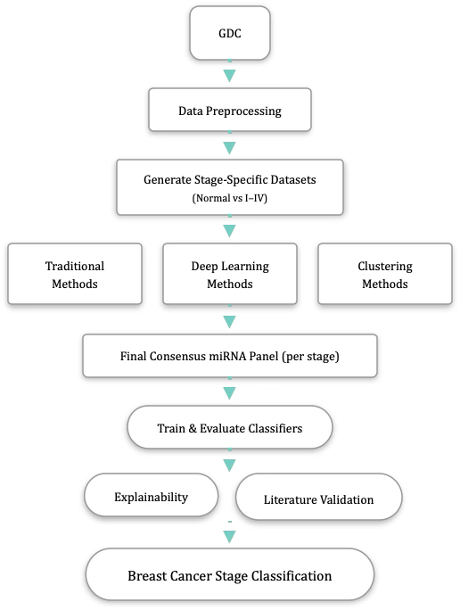

Slide 9
Project Implementation
4

Slide 10
Data Preprocessing
Source: 1,209 TCGA breast cancer miRNA expression files from the GDC Portal
Features: RPM-normalized counts (reads_per_million_miRNA_mapped) to control for sequencing depth
Labeling: linked each expression file to clinical metadata via case_id to assign the correct breast cancer stage
Stage encoding: collapsed sub-stages and encoded Normal–Stage IV as 0–4
Final dataset: 1,209 samples × 1,881 miRNAs with stage labels, ready for feature selection
🧬

Slide 11
Stage-wise Feature Selection
4 Traditional methods: SFS, VT, Chi², LASSO (select top-5/10/15 miRNAs per stage)
4 Deep Learning methods: FNN, DAE, 1D-CNN, LSTM-Seq (select top-5/10/15 miRNAs per stage)
4 Clustering methods: KM, SC, GMM, HC (2 clusters; keep “signal-like” cluster; variable-sized panels)
Shared settings: fixed random seeds; class weights where applicable
Output: 112 stage-wise miRNA lists (all families × stages × panel sizes)
🎯

Slide 12
Stage-wise Consensus
Applied per family (Traditional, Deep Learning, Clustering) per stage (I–IV)
Consensus rules: Intersection (all 4 methods agree) and Majority (at least 2 methods agree)
Very low intersection counts reveal high variability between methods
Output: compact majority-consensus panels per stage and family, used as feature sets for classification
🤝

Slide 13
Project Testing
5

Slide 14
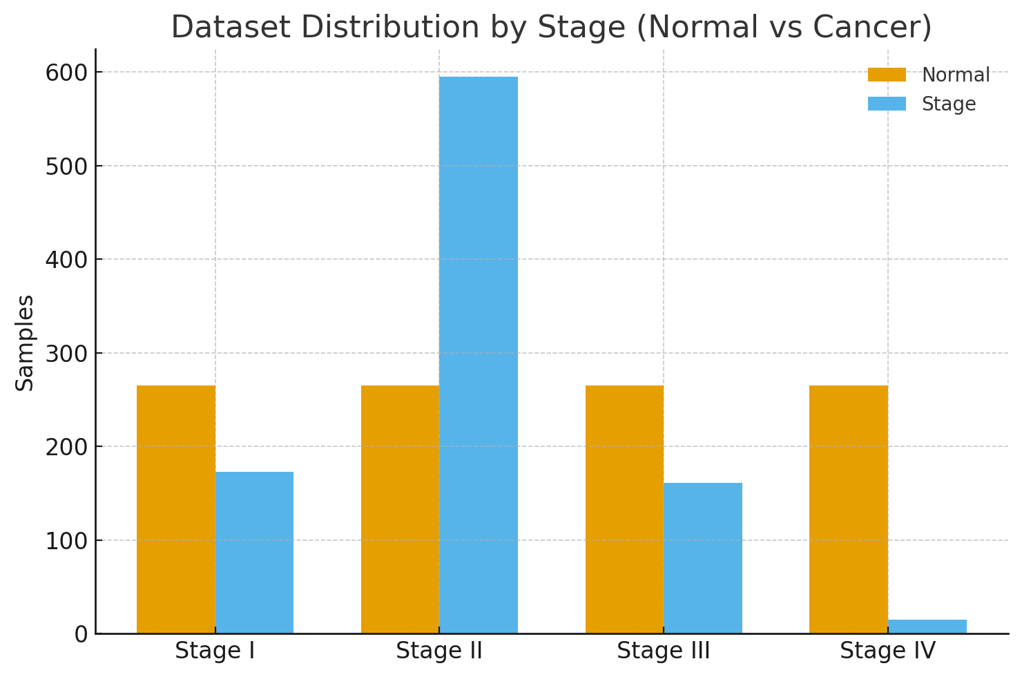
Stage-wise Classification Evaluation
Evaluated majority consensus panels per stage (intersection panels were empty)
Classifiers trained: RF, SVM-linear, LR (all with class weighting) and KNN (unweighted baseline)
Validation approach: 70/30 stratified split (Stages I–III) | stratified 5-fold CV (Stage IV; only 15 positives, strong class imbalance)
Metrics computed: Accuracy, Sensitivity, Specificity, AUC
📊

Slide 15
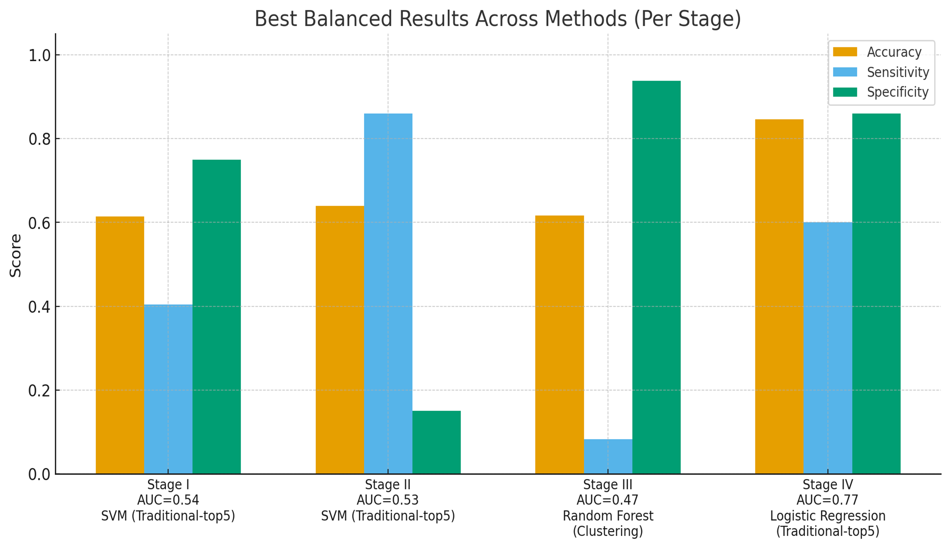
Testing Results
Best Results Across Methods:
Stage I: 61.4% (Traditional-top5 + SVM)
Stage II: 64.0% (Traditional-top5 + SVM)
Stage III: 61.7% (Clustering + RF)
Stage IV: 84.6% (Traditional-top5 + LR)
Key Insights:
Our stage-wise accuracies are in the same range as baseline miRNA-based breast cancer stage classification models reported in the literature [1].
Traditional feature selection gave the most consistent performance at this data scale (high dimensionality, limited samples, class imbalance).
Different feature-selection methods capture complementary miRNA signals, so consensus helps manage method variability.
Stage IV (only 15 cases) and Stage III (low sensitivity) mean accuracy alone can be misleading.

Slide 16
Demonstration
6

Slide 17
Discussion
7

Slide 18
💡 Key Lessons Learned
Methodological Rigor
Strict test set isolation critical for valid results. Stage IV (15 samples) required 5-fold CV instead of train-test split, taught us to adapt validation to data constraints.
2. Implementation Validation
HC cluster-size selection yielded only 1 feature (unbalanced). Switching to variance-based produced 282 features, learned to verify output sanity before proceeding.
3. Complexity ≠ Performance
Traditional methods + consensus features matched deep learning performance. More complex models don't always yield better results for small datasets.
4. Systematic Collaboration
Standardized data splits and file formats enabled fair cross-method comparison. Team coordination essential for meaningful consensus analysis.

Slide 19
References
1. Yerukala Sathipati, S., & Ho, S.-Y. (2018). Identifying a miRNA signature for predicting the stage of breast cancer. Scientific Reports, 8(1), 16138. https://doi.org/10.1038/s41598-018-34604-3

Slide 20

Thank You!

